Slide 1
Summarizing Tolkien's Silmarillion
Eric Wooten MIT 2023

Slide 2
Topics to Cover
Time before the Elves
The Awakening of the Elves
Journey to Aman
Feänor and the Silmarils
Melkor and the Flight of the Noldor
The Noldorin Kingdoms and Doriath
The Great Battles
Beren and Luthien, Turambar
The Fall of the Elven Kingdoms
Eärendil and the War of Wrath

Slide 3
Time before the Elves
The Ainur create the world in the Ainulindale. The mightiest, Melkor, sows discord in the music and rebels against the creator Eru
The Valar and many Maiar enter the world, along with Melkor’s faction
Melkor builds Utumno
The Valar isolate Aman from Arda via the Pelori and create the Two Trees

Slide 4
Awakening of the Elves
144 Elves awake in Cuiviénen
Melkor abducts some of the Elves
Oromë discovers the Elves
The Valar destroy Utumno and imprison Melkor
Oromë invites the Elves to Aman

Slide 5
Journey to Aman (Valinor)
The Elves send three ambassadors to learn about Valinor--Finwë, Ingwë, and Olwë (Thingol)
Some Elves accept the summons--the Noldor, the Vanyar, and the Teleri
The Teleri split several times along the journey
Olwë lost in the woods with Melian
The remaining journeyers arrive in Valinor and learn from the Ainur

Slide 6
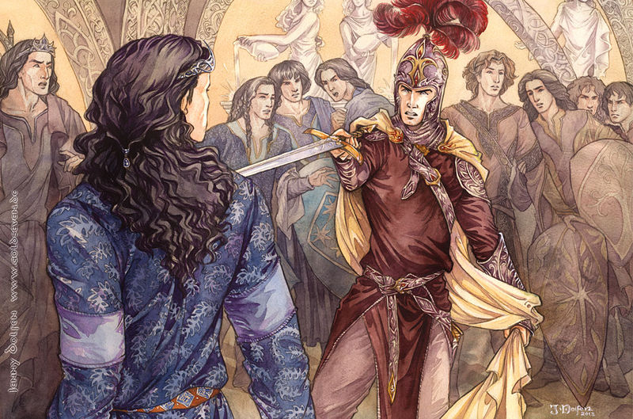
Feanor and the Silmarils
The Noldorin King Finwë bears a son, Feänor
Feänor is the uber-elf
Feänor creates the Silmaril jewels from the light of the Trees
Feänor is banished to Formenos after drawing a blade against his brother Fingolfin, Finwë follows
Feänor returns to reconcile with Fingolfin

Slide 7
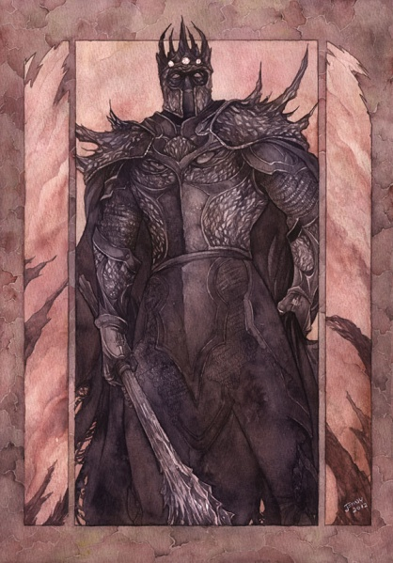
Melkor becomes Morgoth
After long years, Melkor feigns rehabilitation and is released
Melkor sows distrust among the Elves
Melkor allies with Ungoliant and kills the Trees
Fleeing Valinor for Arda, Melkor kills Finwë and steals the Silmarils
Feänor names him Morgoth
Morgoth occupies Angband

Slide 8
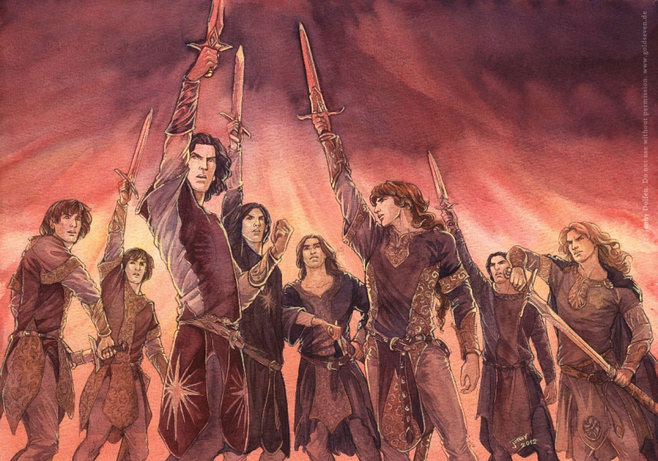
The Flight of the Noldor
Feänor and his seven sons swear the Oath of Feänor
The greater part of the Noldor resolve to retake the Silmarils by force
Feänor leads a group to the Teleri, and commits the First Kinslaying
The Doom of Mandos curses the Noldor to ruin and isolation from the Valar
Fingolfin leads the remaining Noldor across the Helcaraxë

Slide 9
The Great Battles
The First Battle
Dagor-nuin-Giliath (Battle-under-Stars)
Dagor Aglareb (Glorious Battle)
Dagor Bragollach (Battle of the Sudden Flame)
Nirnaeth Arnoediad (Battle of Unnumbered Tears)

Slide 10
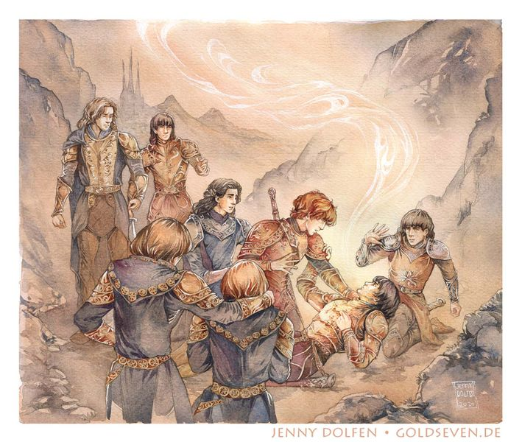
Dagor-nuin Giliath
Feänor arrives in Arda, destroys an initial party of orcs
Pursuing the routed orcs, Feänor is struck down by the balrogs
The remaining Feänorians pause to regroup until Fingolfin arrives
The Valar create the Sun and the Moon

Slide 11
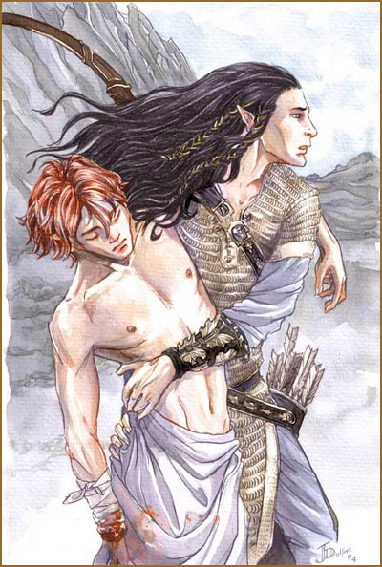
Dagor Aglareb
Maedhros captured by Morgoth, rescued by Fingon
Maedhros relinquishes the kingship to Fingolfin
The Noldor eradicate an army of Morgoth and establish the Siege of Angband
~400 years of near total peace while Morgoth plots anew

Slide 12
The Elven Realms
Thingol remains in isolation in Doriath, but grants lands to the Noldor
Fingolfin rules the Noldor as High King from Hithlum
Finrod establishes Nargothrond
Turgon establishes Nevrast, then Gondolin
The Sons of Feänor occupy East Beleriand
Círdan establishes the Havens of Sirion
The three houses of Men enter Beleriand

Slide 13
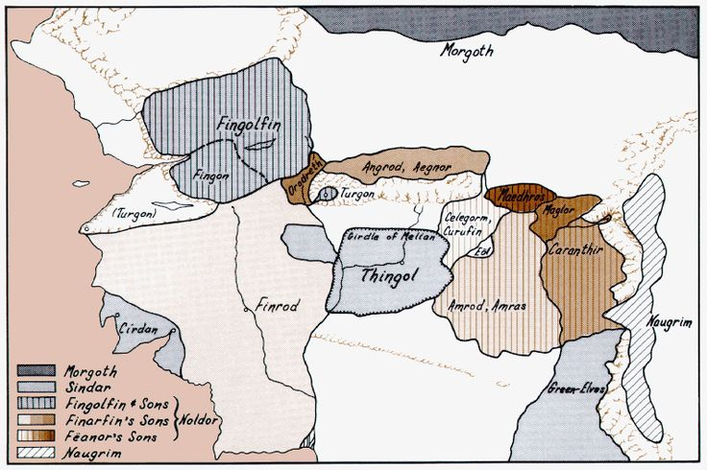

Slide 14
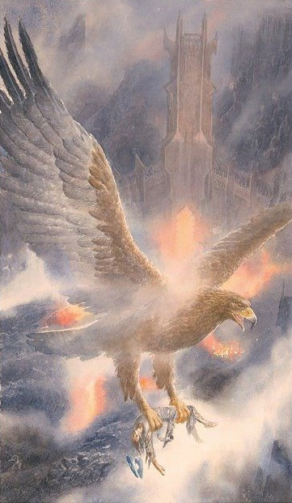
Dagor Bragollach
Morgoth releases rivers of fire and the dragon Glaurung against the besieging Noldor
The Noldor present annihilated
Morgoth free to raid and harry
Fingolfin challenges Morgoth to single combat

Slide 15
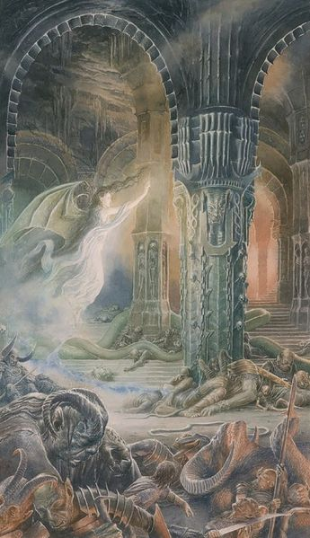
Beren and Luthien
Beren and Luthien meet in the woods and fall in love
Thingol considers Beren unworthy of his daughter, issues a challenge to retrieve a Silmaril
Beren accepts and, with the aid of Finrod, Luthien, and the hound Huor, obtains one
Before returning, the wolf Carcharoth devours the Silmaril and Berens hand
Thingol accepts Beren and leads a hunt for Carcharoth
Beren and Luthien die, then return

Slide 16
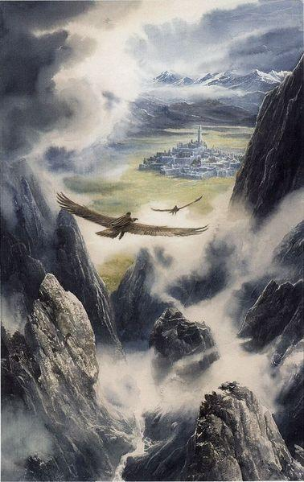
Events in Gondolin
Maeglin arrives in Gondolin, falls in love with the king’s daughter Idril
Húrin and Huor separated in battle and brought to Gondolin by the Eagles
Turgon befriends them, allows them to leave after a year

Slide 17
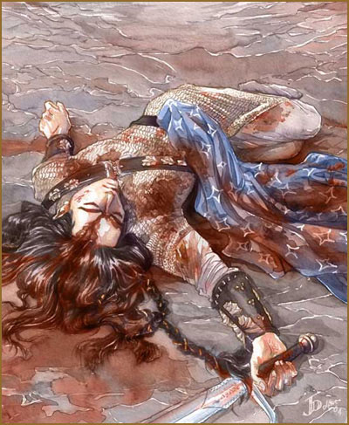
Nirnaeth Arnoediad
Fingon, the Sons of Feänor, Dwarves, and Men march against Angband
Nargothrond and Doriath take no part
Turgon marches with ten thousand Elves from Gondolin
Treachery from one of the tribes of Men turns near victory to catastrophic defeat
Fingon killed, Húrin captured
Hithlum overrun

Slide 18
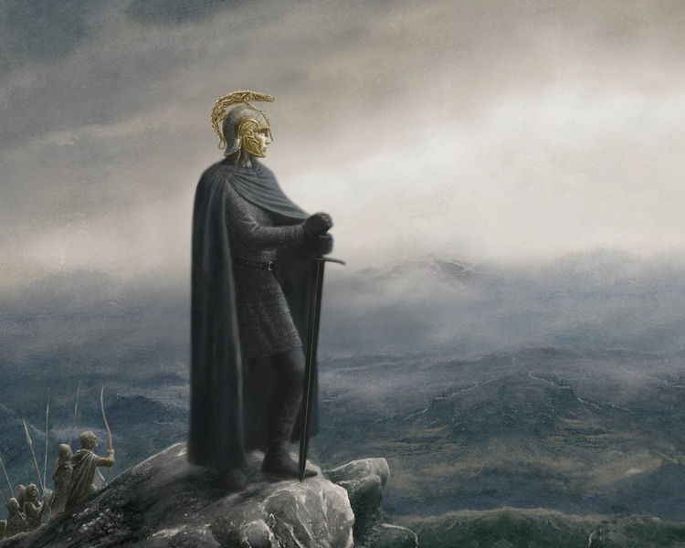
Túrin Turambar
After the Nirnaeth, Túrin sent to Doriath. Thingol raises him as an adopted son
Túrin leaves Doriath and joins a band of outlaws
Túrin betrayed and enters Nargothrond
Túrin’s counsel leads to the sack of Nargothrond
Túrin settles in Brethil and marries Niníel
Túrin kills Glaurung, then himself
Niníel kills herself

Slide 19
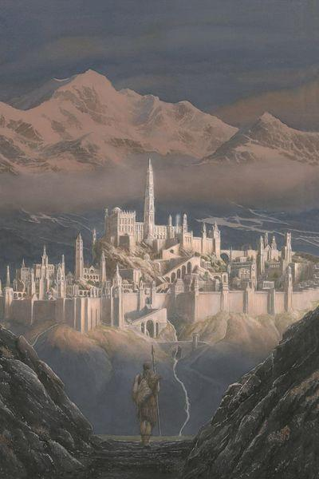
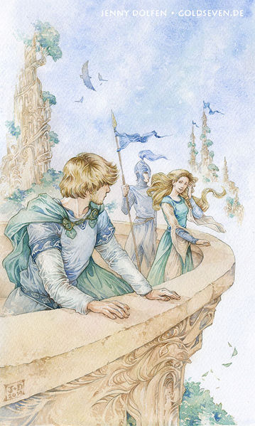
Tuor
Cousin of Túrin, Tuor escapes misfortune with help from Ulmo
Ulmo guides Tuor to Gondolin, where Turgon accepts him
Tuor and Idril fall in love and marry

Slide 20
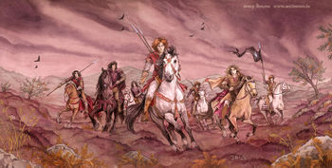
The Fall of Doriath
Húrin released from Angband
Húrin reveals Gondolin and brings the Nauglamir to Thingol
Thingol has dwarves set the Silmaril in the Nauglamir; they kill him for it
Dwarves sack Menegroth, Beren later defeats their army
Beren’s son Dior restores Doriath, wears the Silmaril
The Sons of Feänor destroy Doriath, Elwing escapes with the Silmaril

Slide 21
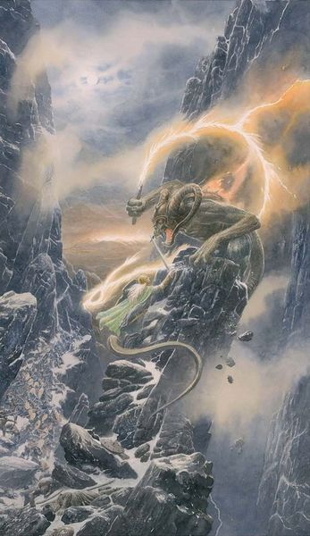
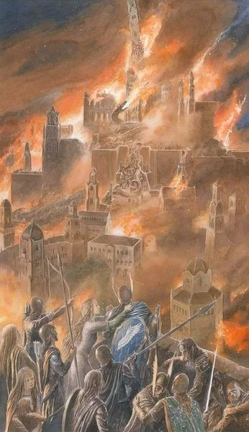
Fall of Gondolin
Morgoth learns the general location of the city from Húrin
Morgoth captures Maeglin, who betrays the secret paths
Morgoth invades
Tuor kills Maeglin and leads a group of survivors through a secret pass to safety in Sirion

Slide 22
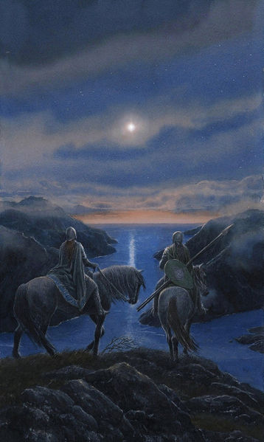
Eärendil and the Valar
Eärendil and Elwing have twins, Elros and Elrond
Eärendil sails, seeking Valinor
The remaining Sons of Feänor destroy the Havens of Sirion
Elwing flees with the Silmaril into the sea, Ulmo aids her to reach Eärendil
Eärendil reaches Valinor and pleads for the aid of the Valar
The Valar accept and march against Morgoth
Eärendil tasked to sail the skies with the Silmaril as a star of hope

Slide 23
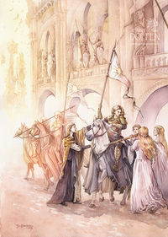
The War of Wrath
The host of the Valar destroy Angband and capture Morgoth
Eärendil slays the dragon Ancalagon with his ship
Balrogs killed or scattered
Sauron put to hiding
The other two Silmarils seized by the host of the Valar, then stolen by the last two Sons of Feänor
Many of the surviving Elves return to Valinor, Galadriel and Gil-galad lead those who remain in Arda
Beleriand ruined and sunk in the war

Slide 24
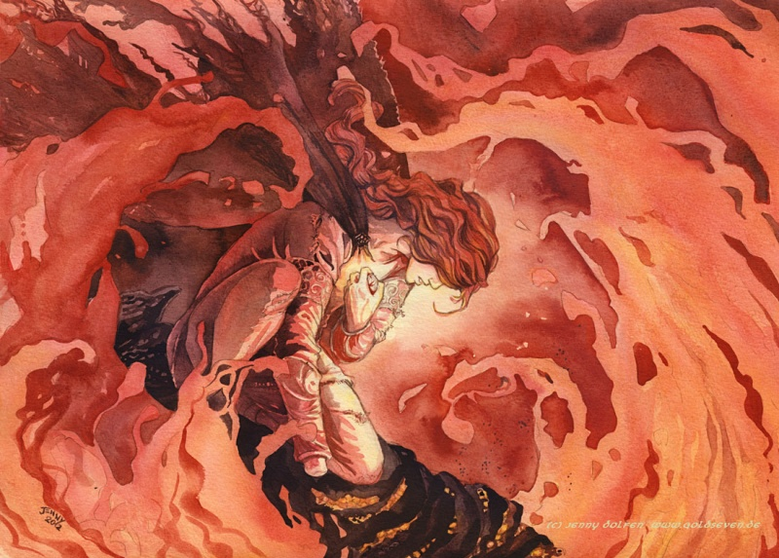
Fate of the Silmarils
Eärendil bears one across the skies
Maedhros throws his and himself into a chasm opened in the ruin of Beleriand
Maglor throws his into the sea

Slide 25
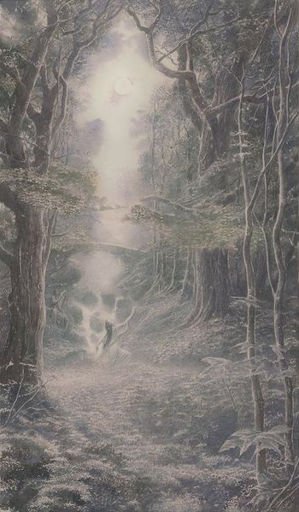
Image Credit
All images either from Alan Lee, Karen Fonstad, or Jenny Dolfen

